Slide 1

Marketing Attribution –
CoolTShirts
Analyze Data with SQL
Athena Mascarenhas
September 14th, 2024

Slide 2
Table of Contents
Project Description
Company Information
3. User Journey
4. Conclusion

Slide 3
1. Project Description

Slide 4
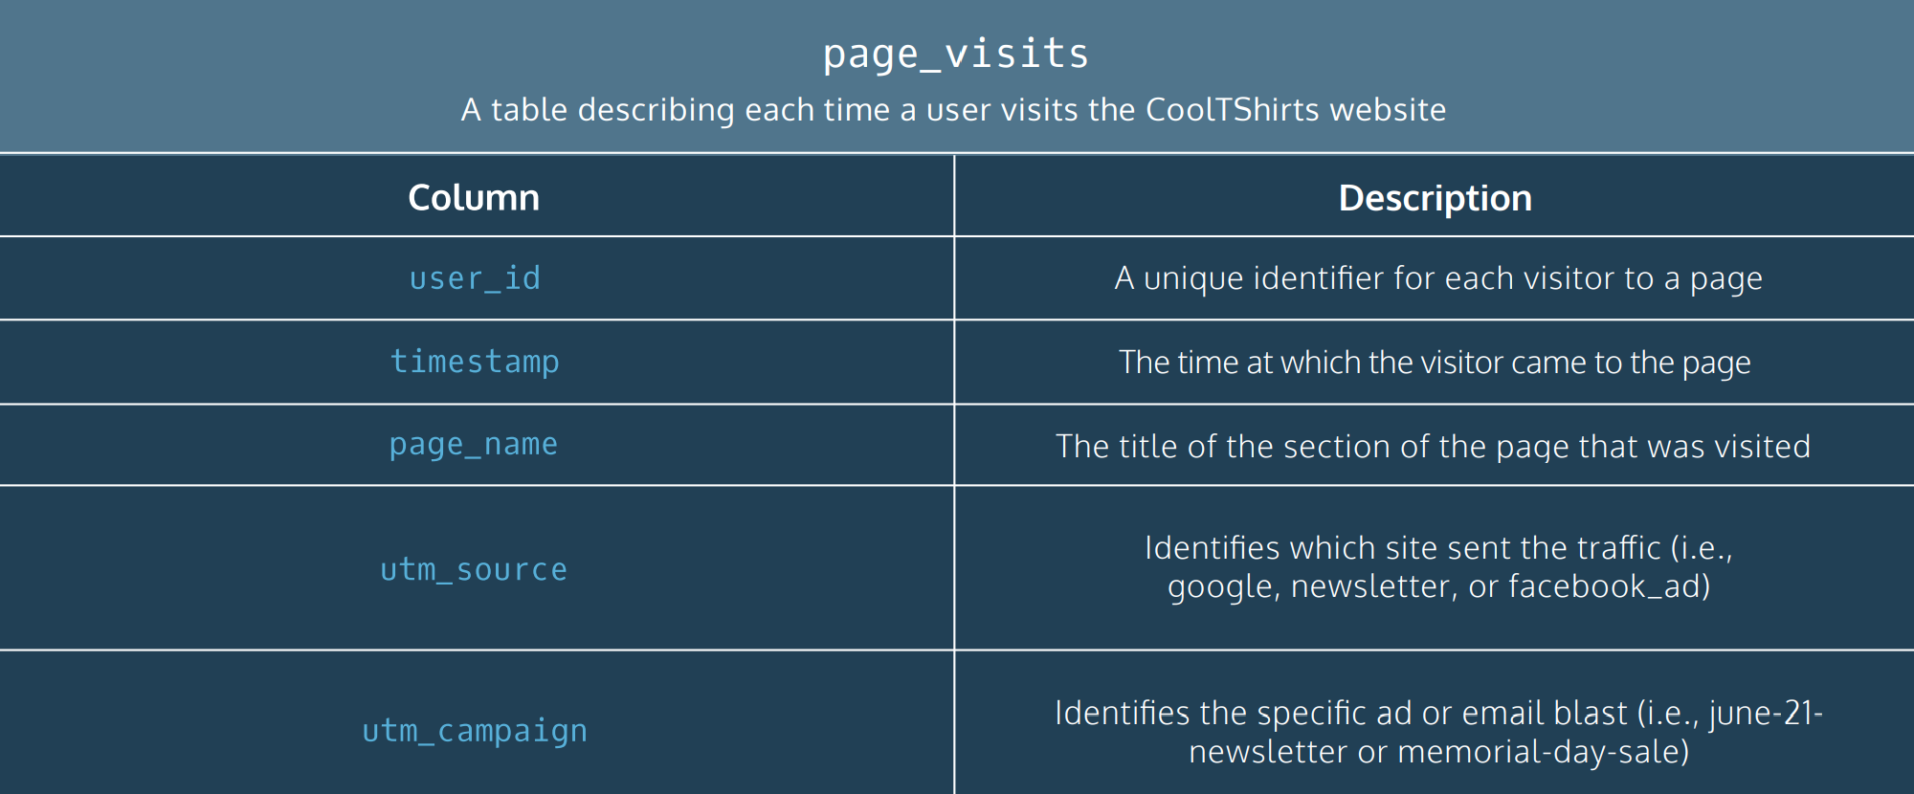
1. Project Description
CoolTShirts sells shirts of all kinds, as long as they are T-shaped and cool. Recently, CTS started a few marketing campaigns to increase website visits and purchases. Using market attribution, they’d like to map their customers’ journey: from initial visit to purchase. They can use that information to optimize their marketing campaigns. This project will guide you through some of that process. We will use the page_visits table (information below).

Slide 5
2. Company Information

Slide 6
2.1 Company Information
CoolTShirts, an innovative apparel shop, is running a bunch of marketing campaigns.
Here is the snippets of the data:
SELECT * FROM page_visits LIMIT 10;
page_name | timestamp | user_id | utm_campaign | utm_source
1 - landing_page | 2018-01-24 03:12:16 | 10006 | getting-to-know-cool-tshirts | nytimes
2 - shopping_cart | 2018-01-24 04:04:16 | 10006 | getting-to-know-cool-tshirts | nytimes
3 - checkout | 2018-01-25 23:10:16 | 10006 | weekly-newsletter | email
1 - landing_page | 2018-01-25 20:32:02 | 10030 | ten-crazy-cool-tshirts-facts | buzzfeed
2 - shopping_cart | 2018-01-25 23:05:02 | 10030 | ten-crazy-cool-tshirts-facts | buzzfeed
3 - checkout | 2018-01-28 13:26:02 | 10030 | retargetting-campaign | email
4 - purchase | 2018-01-28 13:38:02 | 10030 | retargetting-campaign | email
1 - landing_page | 2018-01-05 18:31:17 | 10045 | getting-to-know-cool-tshirts | nytimes
2 - shopping_cart | 2018-01-05 21:16:17 | 10045 | getting-to-know-cool-tshirts | nytimes
3 - checkout | 2018-01-09 03:05:17 | 10045 | retargetting-ad | facebook

Slide 7
2.2 Company Information: Distinct Campaigns and Sources
There are 8 unique ad campaigns:
There are 6 unique sources:
SELECT DISTINCT utm_campaign
from page_visits;
SELECT DISTINCT utm_source
from page_visits;
utm_campaign
getting-to-know-cool-tshirts
weekly-newsletter
ten-crazy-cool-tshirts-facts
retargetting-campaign
retargetting-ad
interview-with-cool-tshirts-founder
paid-search
cool-tshirts-search
utm_source
nytimes
email
buzzfeed
facebook
medium
google

Slide 8
2.2 Company Information: Distinct Campaigns and Sources
SELECT DISTINCT utm_campaign, utm_source
from page_visits;
There are 8 distinct ad campaigns on 6 different sources
Email was the source of 2 different ad campaigns
Google was the source of 2 different ad campaigns
All other sources have one unique ad campaign associated with that source.
utm_campaign | utm_source
getting-to-know-cool-tshirts | nytimes
weekly-newsletter | email
ten-crazy-cool-tshirts-facts | buzzfeed
retargetting-campaign | email
retargetting-ad | facebook
interview-with-cool-tshirts-founder | medium
paid-search | google
cool-tshirts-search | google

Slide 9
2.3 Company Information: Pages
There are 4 pages on the CoolTShirts website :
SELECT DISTINCT page_name
from page_visits;
page_name
1 - landing_page
2 - shopping_cart
3 - checkout
4 - purchase

Slide 10
3. User Journey

Slide 11
3.1 User Journey: First-Touch campaigns
Users initially discover CoolTShirts through 4 out of the 8 sources/campaigns (first-touches).
Medium’s interview-with-cool-tshirts-founder ad campaign, Nytimes’ getting-to-know-cool-tshirts ad campaign and Buzzfeed’s ten-crazy-cool-tshirts-facts bring in most of the users.
Google’s cool-tshirts-search ad campaign brings in the least number of users.
WITH first_touch AS (
SELECT user_id,
MIN(timestamp) as first_touch_at
FROM page_visits
GROUP BY user_id),
total_users AS (
SELECT COUNT(DISTINCT user_id) AS total_users from page_visits),
ft_counts AS (
SELECT pv.utm_source,
pv.utm_campaign,
total_users,
COUNT(*) as users
FROM first_touch ft
JOIN page_visits pv
ON ft.user_id = pv.user_id
AND ft.first_touch_at = pv.timestamp
CROSS JOIN total_users tu
GROUP BY 1,2
ORDER BY 3 DESC)
SELECT utm_source,
utm_campaign,
users,
ROUND(1.0 * users/total_users,2) as proportion_of_users
FROM ft_counts
ORDER BY 3 DESC;
utm_source | utm_campaign | users | proportion_of_users
medium | interview-with-cool-tshirts-founder | 622 | 0.31
nytimes | getting-to-know-cool-tshirts | 612 | 0.31
buzzfeed | ten-crazy-cool-tshirts-facts | 576 | 0.29
google | cool-tshirts-search | 169 | 0.09

Slide 12
3.2 User Journey: Last-Touch campaigns
All 8 sources/campaigns result in the last-touches.
Email’s weekly-newsletter and facebook’s retargetting-ad results in the largest number of last-touches.
Google’s cool-tshirts-search ad campaign results in the lowest number of last-touches (3%).
All other campaigns fall in between.
WITH last_touch AS (
SELECT user_id,
MAX(timestamp) as last_touch_at
FROM page_visits
GROUP BY user_id),
total_users AS (
SELECT COUNT(DISTINCT user_id) AS total_users from page_visits),
lt_counts AS (
SELECT
pv.utm_source,
pv.utm_campaign,
tu.total_users,
COUNT(*) as users
FROM last_touch lt
JOIN page_visits pv
ON lt.user_id = pv.user_id
AND lt.last_touch_at = pv.timestamp
CROSS JOIN total_users tu
GROUP BY 1,2
ORDER BY 3 DESC)
SELECT utm_source,
utm_campaign,
users,
ROUND(1.0 * users/total_users,2) as proportion_of_users
FROM lt_counts
ORDER BY 3 DESC;
utm_source | utm_campaign | users | proportion_of_users
email | weekly-newsletter | 447 | 0.23
facebook | retargetting-ad | 443 | 0.22
email | retargetting-campaign | 245 | 0.12
nytimes | getting-to-know-cool-tshirts | 232 | 0.12
buzzfeed | ten-crazy-cool-tshirts-facts | 190 | 0.1
medium | interview-with-cool-tshirts-founder | 184 | 0.09
google | paid-search | 178 | 0.09
google | cool-tshirts-search | 60 | 0.03

Slide 13
3.3 User Journey: Purchases
--purchased users
WITH total_users AS (
SELECT COUNT(DISTINCT user_id) AS total_users from page_visits),
purchased AS (
SELECT COUNT(DISTINCT user_id) AS users_that_purchased
from page_visits
where page_name = '4 - purchase')
SELECT total_users,
users_that_purchased,
ROUND(1.0 * users_that_purchased/total_users,2) as proportion_of_users_that_purchased
FROM purchased p
CROSS JOIN total_users;
total_users | users_that_purchased | proportion_of_users_that_purchased
1979 | 361 | 0.18
361 visitors (18%) made a purchase.

Slide 14
3.4 User Journey: Campaigns that led to purchases
There were purchases made on all 8 sources/campaigns
Email’s weekly-newsletter and facebook’s retargetting-ad had the highest number of purchases
Google’s cool-tshirts-search ad campaign has the lowest numbers
All other campaigns fall in between.
WITH last_touch AS (
SELECT user_id,
MAX(timestamp) as last_touch_at
FROM page_visits
where page_name = '4 - purchase'
GROUP BY user_id),
total_users AS (
SELECT COUNT(DISTINCT user_id) AS total_users
from page_visits
where page_name = '4 - purchase'),
lt_counts AS (
SELECT
pv.utm_source,
pv.utm_campaign,
tu.total_users,
COUNT(*) as users
FROM last_touch lt
JOIN page_visits pv
ON lt.user_id = pv.user_id
AND lt.last_touch_at = pv.timestamp
CROSS JOIN total_users tu
GROUP BY 1,2
ORDER BY 3 DESC)
SELECT utm_source,
utm_campaign,
users as users_purchased,
ROUND(1.0 * users/total_users,2) as proportion_of_users_purchased
FROM lt_counts
ORDER BY 3 DESC;
utm_source | utm_campaign | users_purchased | proportion_of_users_purchased
email | weekly-newsletter | 115 | 0.32
facebook | retargetting-ad | 113 | 0.31
email | retargetting-campaign | 54 | 0.15
google | paid-search | 52 | 0.14
buzzfeed | ten-crazy-cool-tshirts-facts | 9 | 0.02
nytimes | getting-to-know-cool-tshirts | 9 | 0.02
medium | interview-with-cool-tshirts-founder | 7 | 0.02
google | cool-tshirts-search | 2 | 0.01

Slide 15
3.5 User Journey: Page Funnel
SELECT page_name,
COUNT(DISTINCT user_id) as users
FROM page_visits
GROUP BY 1;
utm_source | utm_campaign | percentage
1 - landing_page | 1979 | 100%
2 - shopping_cart | 1881 | 95%
3 - checkout | 1431 | 76%
4 - purchase | 361 | 25%
95% of users place items in their shopping cart
76% checkout, but only 25% purchase – Should be explored further

Slide 16
4. Conclusion

Slide 17
4. Conclusion
The five campaigns that CoolTShirts should re-invest in are the following:
Email’s weekly-newsletter:
Even though it is not one of the first-touch campaigns, it resulted in the highest number of purchases.
Facebook’s retargetting-ad:
Like the email’s weekly-newsletter campaign, it is not one of the first-touch campaigns, but it resulted in a high number of purchases. The number of purchases were very close to the number of purchases from email’s weekly-newsletter.
Medium’s interview-with-cool-tshirts-founder:
Brought in the highest number of users even though few people purchase items through the campaign.
NyTimes’s getting-to-know-cool-tshirts:
Close second to the medium, this campaign brought in the second highest number of users
Buzzfeed’s ten-crazy-cool-tshirts-facts:
Also, brought in a high number of users and worth re-investing in.
Medium, NyTimes and Buzzfeed are all first touch campaigns but are worth reinvesting in as it brings in users that can be targeted by the last-touch campaigns and could result in purchases
Further Analysis:
Explore why 95% of visitors add to their shopping cart, but 76% checkout and even fewer buy

